Slide 1

Silicon Labs C8051F020 System Overview
Professor Yasser Kadah – www.k-space.org
Notes:
In this lecture we will look at the many rich features and resources of C8051F020.

Slide 2

Recommended Reference
Embedded Programming with Field Programmable Mixed Signal μController, M.T. Chew and G.S. Gupta.

Slide 3

C8051F020 System Overview
Introduction
C8051F020 system overview
Memory organization
Program and internal data memories
Special function registers
I/O ports
The digital crossbar
12-Bit analog-to-digital converter
8-Bit analog-to-digital converter
Digital-to-analog converter
Comparators
Voltage reference for ADC and DAC
Internal voltage reference generator
Notes:
We will start with a quick overview of C8051F020 and understand the functions of the various features using a block diagram. The program and data memory organisation will be explained. The digital and analog features will be introduced. In the rest of the course, each of these features, such as the digital crossbar, ADC/DAC, Comparators, etc will be dealt with separately in details.

Slide 4
Microprocessors and Microcontrollers
Microprocessor: general-purpose CPU
Emphasis is on flexibility and performance
Generic user-interface such as keyboard, mouse, etc.
Used in a PC, PDA, cell phone, etc.
Microcontroller: microprocessor + memory on a single chip
Emphasis is on size and cost reduction
The user interface is tailored to the application, such as the buttons on a TV remote control
Used in a digital watch, TV remote control, car and many common day-to-day appliances
Notes:
Differences between Microprocessors and Microcontrollers.

Slide 5
Terminology
Integrated Circuit (IC): A miniaturized electronic circuit that consists of semiconductor devices and passive components contained in a package
Central Processing Unit (CPU): This refers to the core of the MCU that executes code
Microcontroller Unit (MCU): This is the standard acronym used for microcontrollers, and refers to the full IC that contains the CPU and peripherals.
“n-bit” – the “n” refers to the data bus width of the CPU, and is the maximum width of data it can handle at a time
Examples: 8-bit MCU, 32-bit MCU
Notes:
Common terminology.

Slide 6
Microcontroller Architectures
Microcontroller architecture refers to the internal hardware organization of a microcontroller
Each hardware architecture has its own set of software instructions called assembly language that allows programming of the microcontroller
Some of the popular microcontroller architectures
Intel 8051
Zilog Z80
Atmel AVR
Notes:
What is architecture, and examples of microcontroller architectures.

Slide 7
Harvard and von Neumann Architectures
Harvard Architecture—a type of computer architecture where the instructions (program code) and data are stored in separate memory spaces
Example: Intel 8051 architecture
von Neumann Architecture—another type of computer architecture where the instructions and data are stored in the same memory space
Example: Intel x86 architecture (Intel Pentium, AMD Athlon, etc.)
Notes:
Basic difference between two of the most common types of architectures.

Slide 8
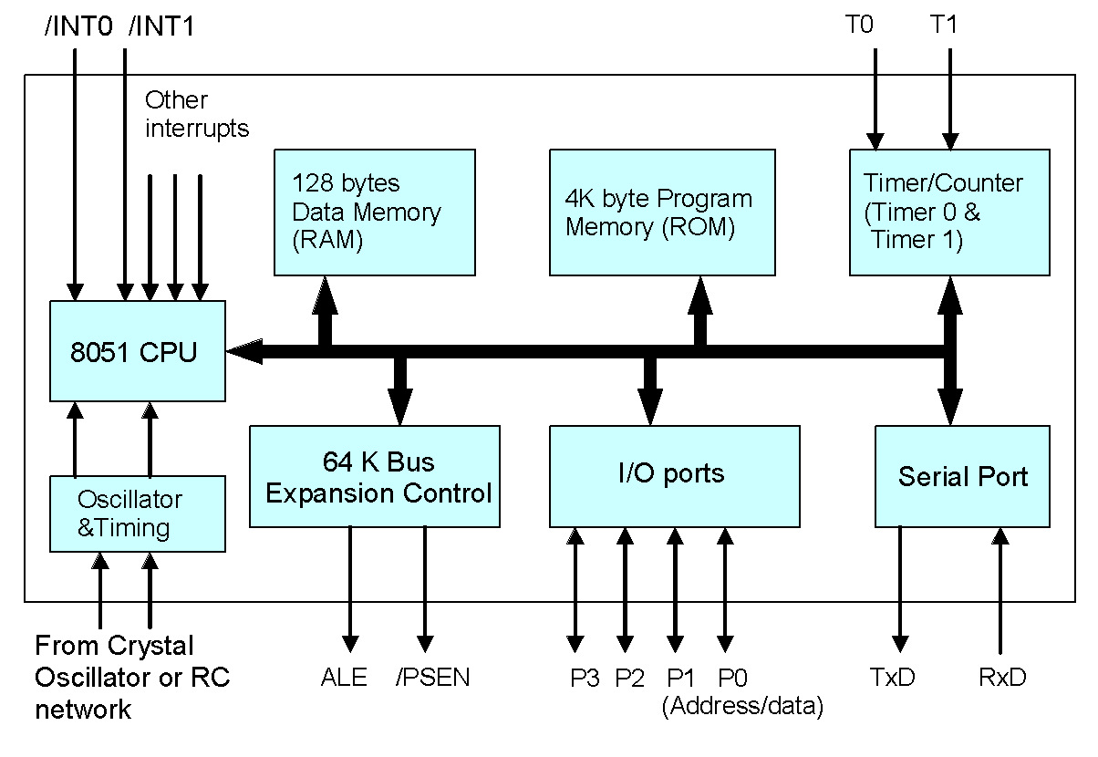
Block Diagram of the Original 8051
Notes:
Only 2 timers and 1 UART for serial communication. Four digital I/O ports. No analog features. 8051 memory can be extended by connecting external memory.

Slide 9
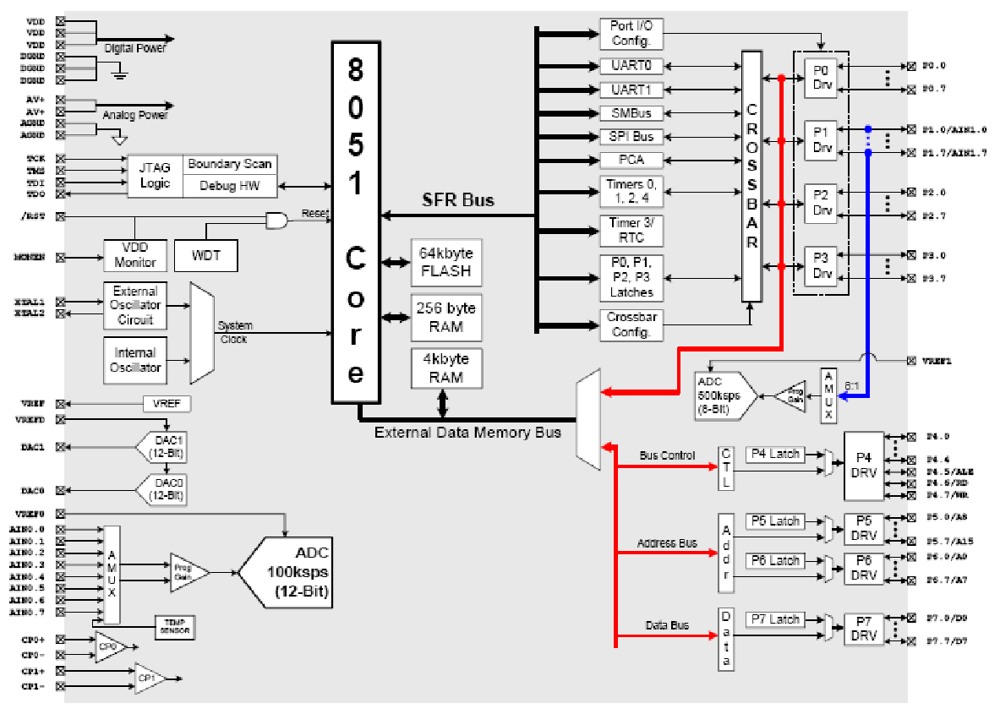
Block Diagram of the Silicon Labs 8051
Notes:
C8051F020 block diagram showing all peripherals.

Slide 10
Is 8-bit Still Relevant?
“n-bit” – the “n” refers to the data bus width of the CPU, and is the maximum width of data it can handle at a time
PCs with 64-bit microprocessors are becoming common
Over 55% of all processors sold per year are 8-bit processors, which comes to over 3 billion of them per year!
8-bit microcontrollers are sufficient and cost-effective for many embedded applications
More and more advanced features and peripherals are added to 8-bit processors by various vendors
8-bit MCUs are well-suited for low-power applications that use batteries
Notes:
Why are we learning 8-bit micros when 64-bit processors are now available? Are the 8-bit micros still used?

Slide 11
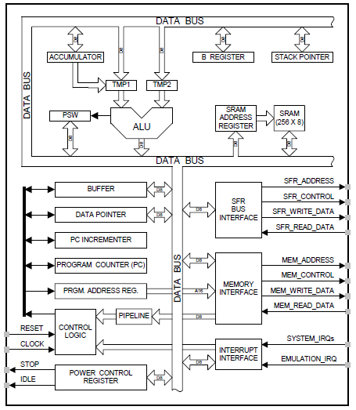
Introduction to CIP-51
CIP-51 is the CPU of the Silicon Labs C8051F020 MCU
The CIP-51 implements the standard 8051 organization, as well as additional custom peripherals
At 25 MHz, it has a peak throughput of 25 millions of instructions per second (MIPS)
The CIP-51 has a total of 109 instructions
Notes:
This diagram shows the CIP-51 core architecture. From a programmer’s point of view, it is not absolutely essential to understand this. This is just to highlight the pipelined architecture of CIP-51 which makes it very fast.

Slide 12
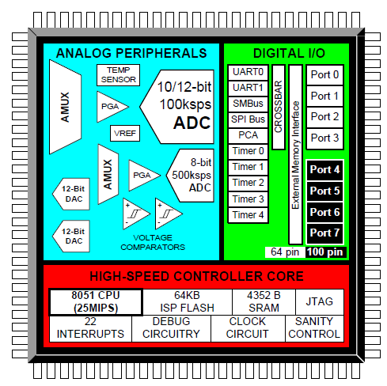
C8051F020 System Overview
The Silicon Labs C8051F020 is a fully integrated mixed-signal system-on-a-chip microcontroller available in a 100-pin package
Mixed-Signal
Contains both digital and analog peripherals
System-on-a-chip (SOC)
Integrates memory, CPU, peripherals, and clock generator in a single package
Notes:
This diagram shows the rich features of the C8051F020. The various modules, such as the DAC, ADC, Timers, comparators, digital I/O ports, UARTs etc are shown as blocks. It combines digital and analog resources on one chip and hence called mixed-signal microcontroller. It is programmed using the JTAG interface and has on-board debug circuitry.

Slide 13
C8051F020 System Overview—Features
Peak throughput | 25 MIPS
FLASH program memory | 64 K
On-chip data RAM | 4352 bytes
Full-duplex UARTS | x 2
16-bit timers | x 5
Digital I/O ports | 64-pin
12-bit 100 ksps ADC | 8 channels
8-bit 500 ksps ADC | 8 channels
DAC resolution | 12-bit
DAC outputs | x 2
Analog comparators | x 2
Interrupts | 2 levels
PCA (programmable counter arrays) | 5 channels
Internal oscillator | 25 Mhz
Debug circuitry
Notes:
This is a summary of the C8051F020 features. As you can see, this is a lot more than what was available on a basic 8051.

Slide 14
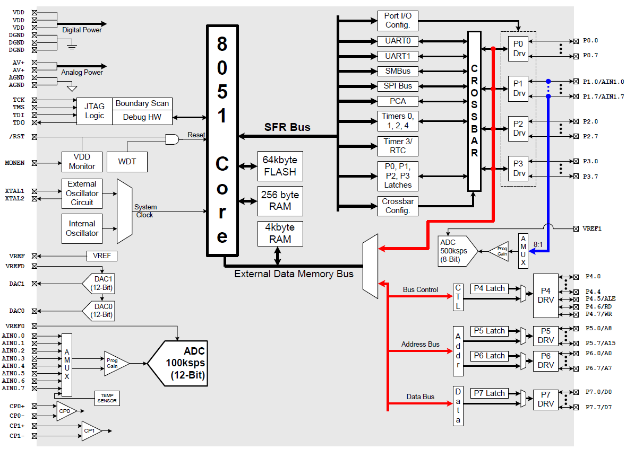
C8051F020 Functional Block Diagram
Notes:
This diagram again shows the various modules of C8051F020. Additionally it shows the various external pins available and their pin names. Note, for example, that the 12-bit ADC has dedicated pins for analog input channels where as the 8-bit ADC shares its inputs with the digital port 1. Other details that can be seen are the availability of external pins for voltage reference for ADC and DAC, pins for analog comparator inputs, internal oscillator etc.

Slide 15
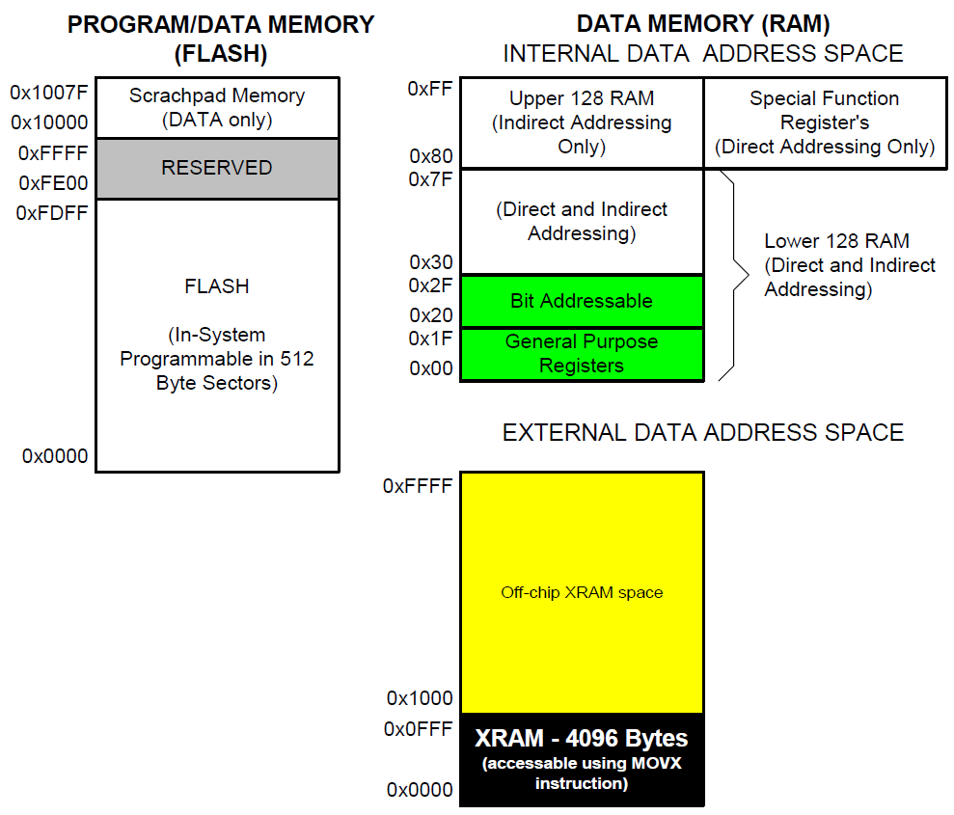
Memory Organization
The memory organization of C8051F020 is similar to that of a standard 8051
Program and data memory share the same address space but are accessed via different instruction types
Notes:
The memory organisation of C8051F020 is very similar to that of the basic 8051, especially the internal data memory and its layout in terms of register banks, bit-addressable space and location of SFRs.

Slide 16
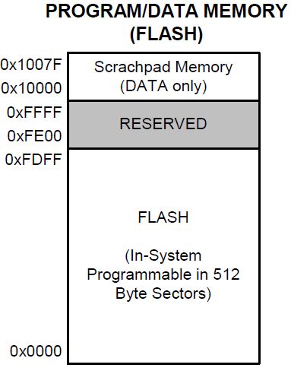
Program Memory
FLASH memory
Can be reprogrammed in-circuit
Provides non-volatile data storage
Allows field upgrades of the 8051 firmware
The C8051F020’s program memory consists of 65536 bytes of FLASH
512 bytes from addresses 0xFE00 to 0xFFFF are reserved for factory use
128 bytes at address 0x10000 to 0x1007F (scratchpad memory) can be used as non-volatile storage of program constants
Notes:
The FLASH memory provides non-volatile data storage and can be reprogrammed in-circuit. This allows field upgrades of the firmware.

Slide 17
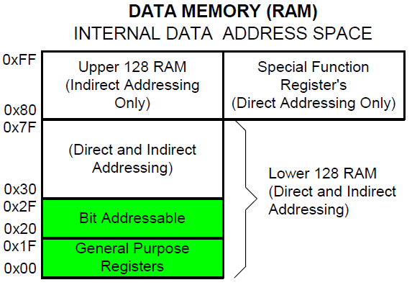
Internal Data Memory
The internal data memory consists of 256 bytes of RAM
The special function registers (SFR) are accessed when the direct addressing mode is used to access the upper 128 bytes of memory locations from 0x80 to 0xFF
The general purpose RAM are accessed when indirect addressing is used to access the upper 128 bytes
The first 32 bytes of the internal data memory are addressable as four banks of 8 general purpose registers
The next 16 bytes are bit-addressable or byte-addressable
Notes:
The data memory organisation of C8051F020 is very similar to that of the basic 8051. The difference is in the number of SFRs, which is much higher for C8051F020 as compared to 8051.

Slide 18
Special Function Registers
SFRs provide control and data exchange with the microcontroller’s resources and peripherals
The C8051F020 duplicates the SFRs found in a typical 8051 implementation
The C8051F020 implements additional SFRs which are used to configure and access the sub-systems unique to the microcontroller
This allows the addition of new functionalities while retaining compatibility with the MCS-51™ instruction set
The SFRs with addresses ending in 0x0 or 0x8 (e.g. P0, TCON, P1, SCON, IE, etc.) are bit-addressable as well as byte-addressable
Notes:
Backward compatibility with the MCS-51 instruction set has been maintained.

Slide 19
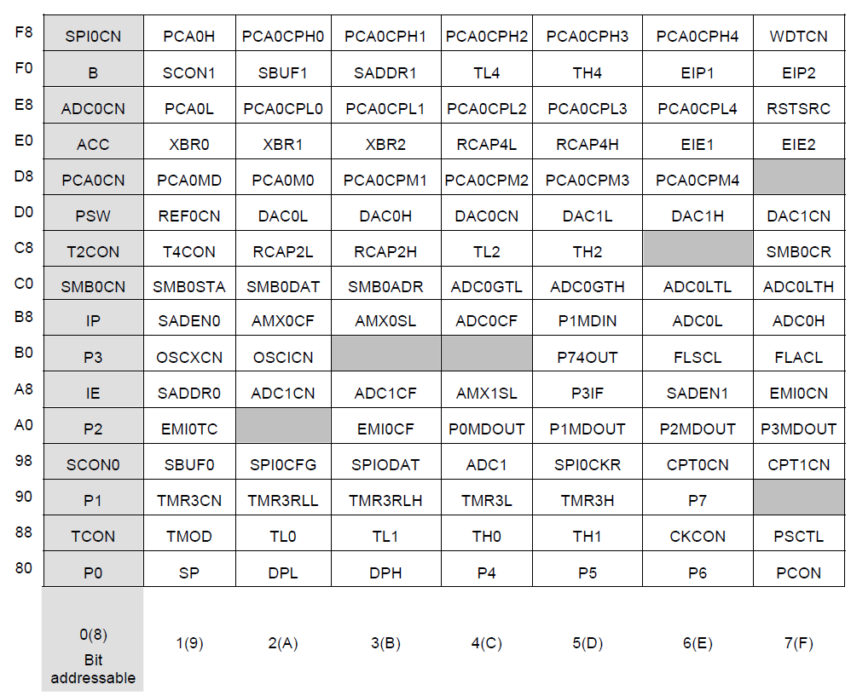
Special Function Registers
Notes:
Recap from last lecture.

Slide 20
I/O Ports
Ports 0, 1, 2 and 3 are bit- and byte-addressable
Four additional ports (4, 5, 6 and 7) are byte-addressable only
There are a total of 64 general purpose port I/O pins
Access to the ports is possible through reading and writing the corresponding port data registers (P0, P1, etc.)
All port pins are 5 V tolerant and support configurable input/output modes and weak pull-ups
In addition, the pins on Port 1 can be used as analog inputs to ADC1
Notes:
Input and output of data through the port is handled by the Port Data Registers. The lower four ports (Ports 0, 1, 2, and 3) are bit- as well as byte-addressable. The upper four ports (4, 5, 6, and 7) are byte-addressable only.
Port 1 doubles up as analog input port for the 8-bit ADC.

Slide 21
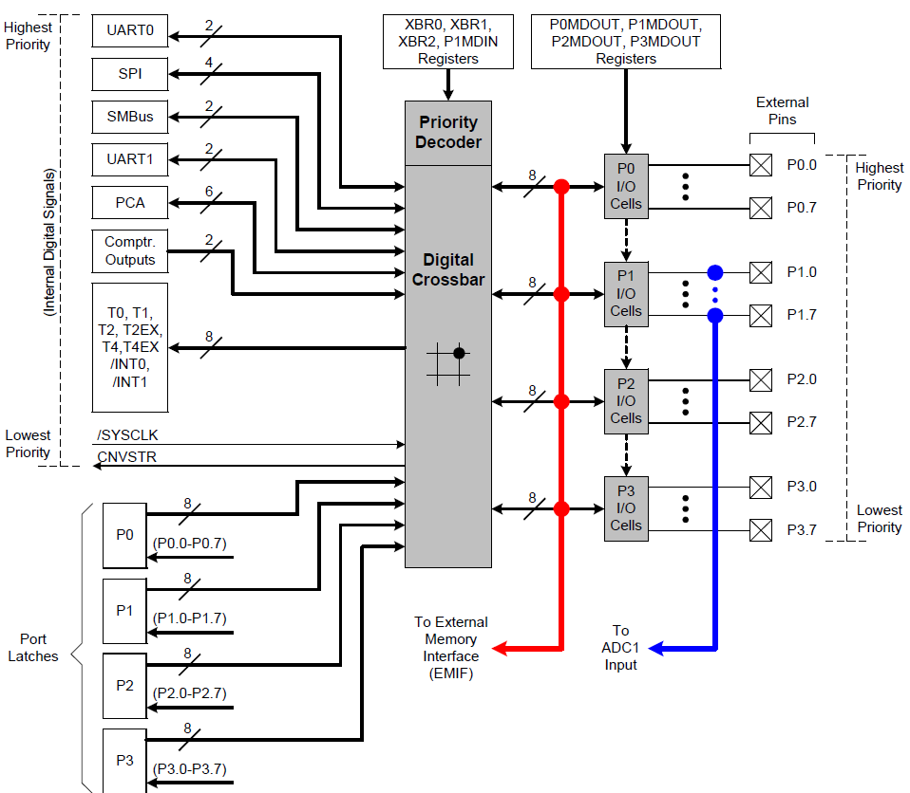
The Digital Crossbar
The digital crossbar is essentially a large digital switching network that allows mapping of internal digital peripherals to the pins on Ports 0 to 3
This is achieved by configuring the crossbar control registers XBR0, XBR1 and XBR2
Allows the system designer to select the exact mix of GPIO and digital resources needed for the particular application
Notes:
This picture shows the Digital Crossbar and the peripherals which can be selectively connected through it to the external pins of the microcontroller. The Digital Crossbar is essentially a large digital switching network that allows mapping of internal digital peripherals to the pins on Ports 0 to 3. This is achieved by configuring the Crossbar Control Registers XBR0, XBR1 and XBR2.

Slide 22
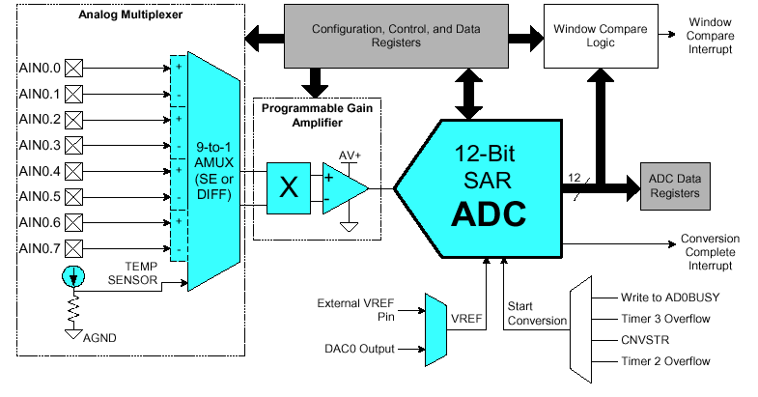
12-Bit Analog-to-Digital Converter (ADC0)
On-chip 12-bit successive approximation register (SAR) analog-to-digital converter (ADC0)
9-channel input multiplexer and programmable gain amplifier
The ADC is configured via its associated special function registers
One input channel is tied to an internal temperature sensor, while the other 8 channels are available externally
Notes:
This diagram shows the 12-Bit ADC module. It can convert at the rate of 100 ksps. Various SFRs are associated with this modules and are used to configure it such as single-ended or differential input mode, channel selection, gain of the amplifier, the start-of-conversion method, etc. The 12-bit converted value is available in the ADC data register. The reference voltage for the ADC is either from the external VREF pin or the DAC0 output. The Window Compare Logic allows us to set a window (lower and upper threshold voltages) so that when the measured analog value is outside this window, an interrupt is generated. This feature is useful in monitoring voltages and generating alarms. The details of the ADC will be covered in a separate lecture.

Slide 23
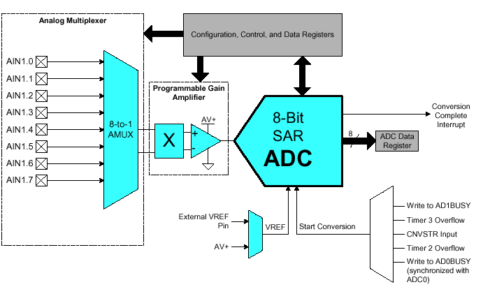
8-Bit Analog-to-Digital Converter (ADC1)
On-board 8-bit SAR analog-to-digital converter (ADC1)
Port 1 can be configured for analog input
8-channel input multiplexer and programmable gain amplifier
The ADC is configurable via its configuration SFRs
Notes:
This diagram shows the 8-Bit ADC module. It can convert at the rate of 500 ksps. Various SFRs are associated with this modules and are used to configure it such as channel selection, gain of the amplifier, the start-of-conversion method, etc. The 8-bit converted value is available in the ADC data register. The reference voltage for the ADC is either from the external VREF pin or the supply voltage AV+. The details of the ADC will be covered in a separate lecture.

Slide 24
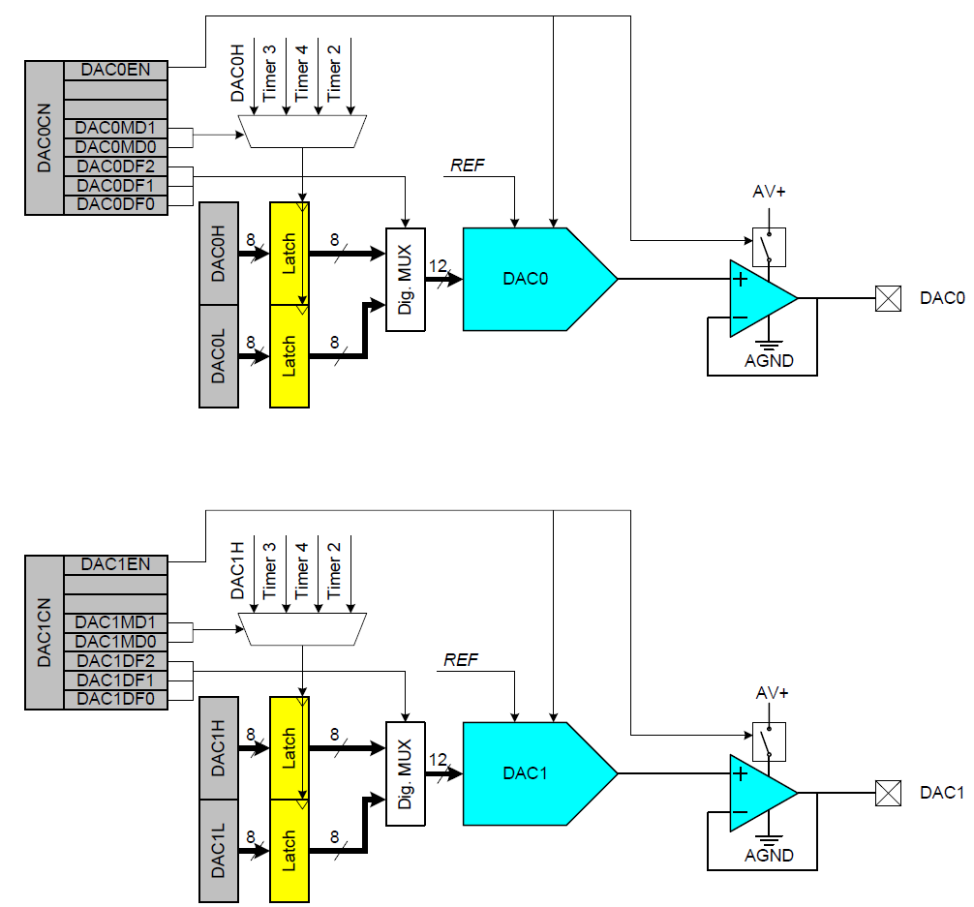
Digital-to-Analog Converters
Two 12-bit digital-to- analog converters: DAC0 and DAC1
The DAC voltage reference is supplied via the dedicated VREFD input pin
The DACs are especially useful as references for the comparators
Notes:
There are two 12-bit Digital to Analog Converters, DAC0 and DAC1. They are identical in their operations albeit using different SFRs.
There are several ways to initiate the conversion and it can be programmed.

Slide 25
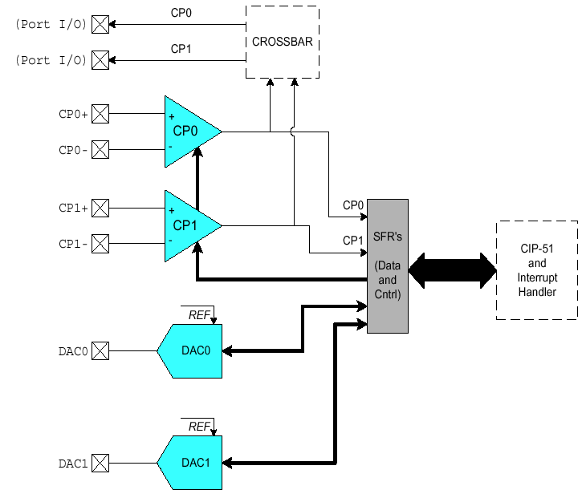
Comparators
There are two analog comparators on chip: CP0 and CP1
The comparators have software programmable hysteresis
Generate an interrupt on its rising edge, falling edge or both
The comparators' output state can also be polled in software and programmed to appear on the lower port I/O pins via the crossbar
Notes:
This picture shows the configuration of the analog comparators. The hysteresis for the comparators can be programmed. Comparators will be covered in details in a later chapter.

Slide 26

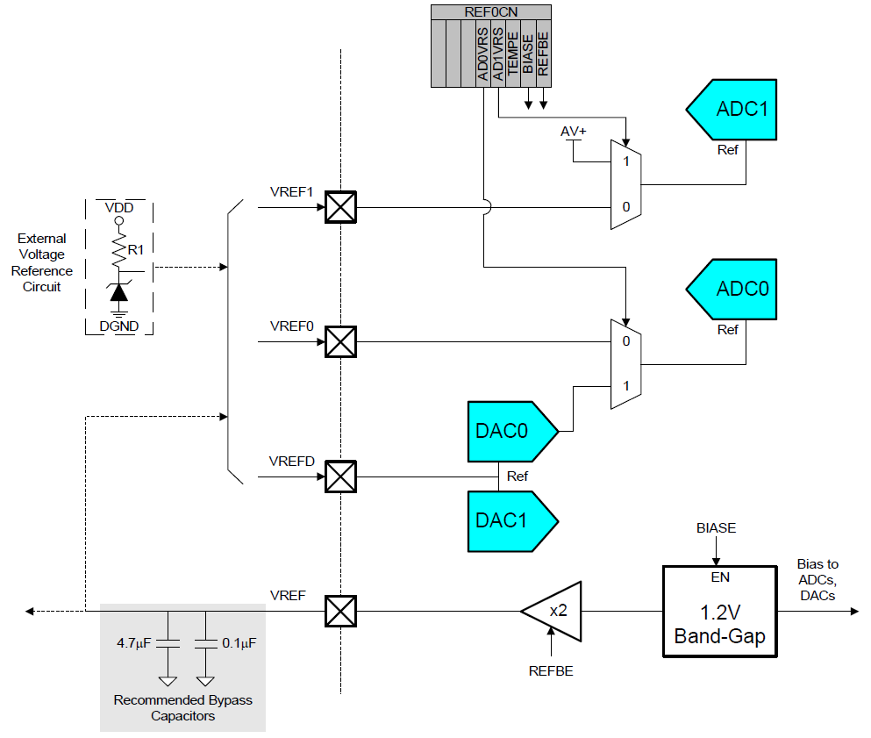
Voltage Reference for ADC and DAC
A voltage reference has to be used when operating the ADC and DAC
Three external voltage reference input pins: VREF0, VREF1 and VREFD
ADC0 may also reference the DAC0 output internally
ADC1 may also reference the analog power supply voltage (AV+)
Notes:
This diagram gives the overview of the various voltage references for the ADCs and DACs. Instead of using the internal band-gap voltage generator, one can use an external voltage reference too.

Slide 27
www.silabs.com/MCU

